Slide 1
Reproduction and Development
Derrick Liang
November 8, 2019

Slide 2
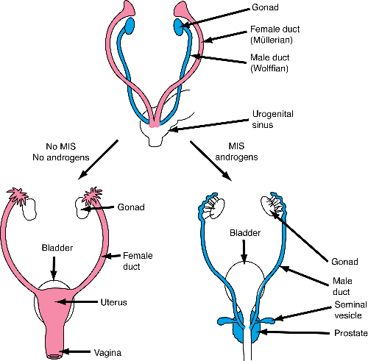
Sexual Differentiation
Sex-determining region Y
Absence => female
2 or more X’s + Y - Klinefelter
XO - Turner Syndrome
Wolffian vs. Müllerian ducts

Slide 3
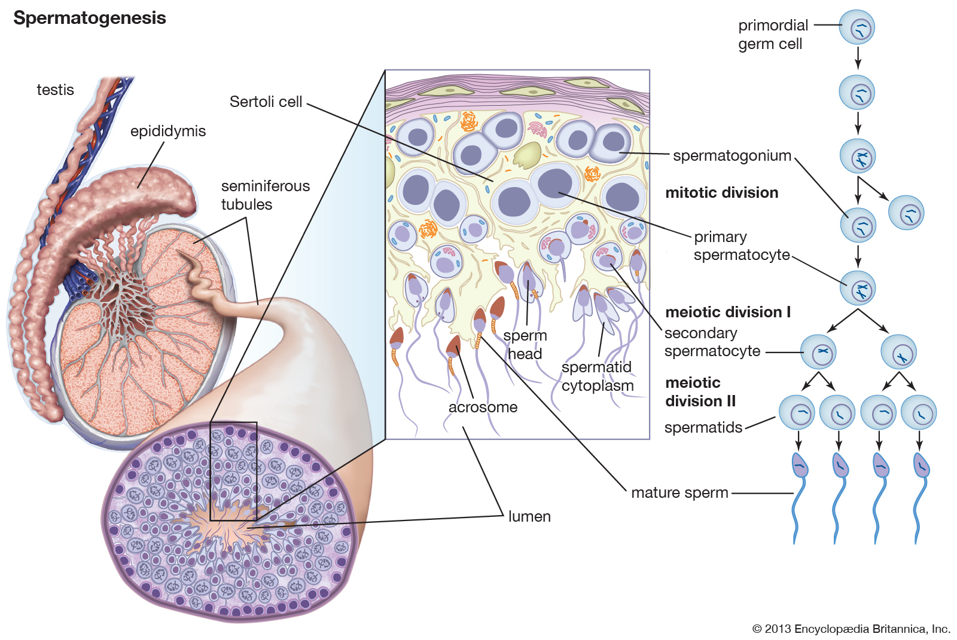
Blood-testis barrier
Acrosome, nucleus, centriole pair, and mitochondria wrapped around flagellum
Notes:
Pathway: Seminiferous tubules -> epididymis (gain motility) -> vas deferens -> (seminal vesicles, prostate gland, and bulbourethral glands contribute to semen) -> urethra -> vagina -> cervix -> uterus (egg meets it here)

Slide 4
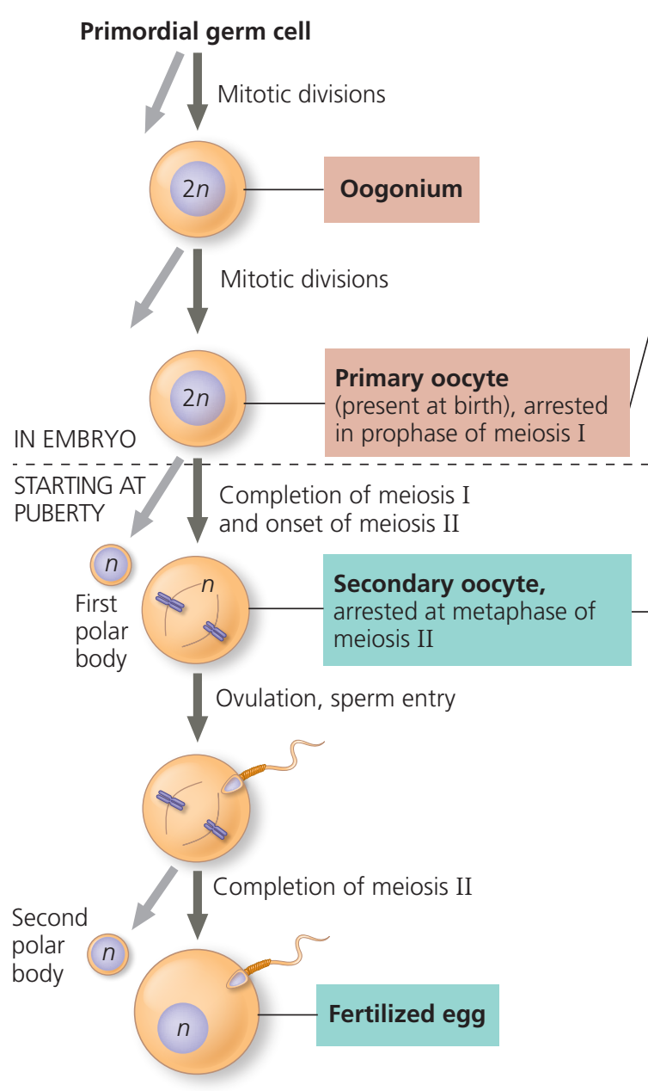
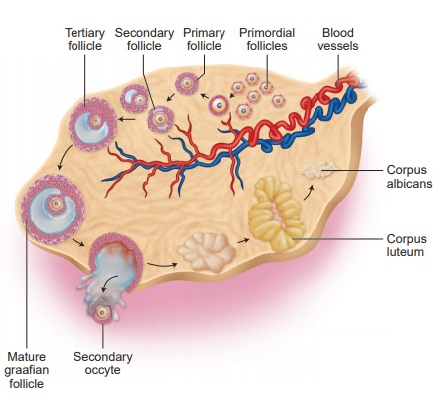
Notes:
Key distinction!
Oogonia complete all of their divisions before birth. That is, the ~2 million primary oocytes they have, arrested in prophase I, is all they have. During each menstrual cycle, one of the primary oocytes can finish meiosis I, but then it is arrested at metaphase II, only completing meiosis II upon sperm fertilization.
On the other hand, spermatogenesis are arrested in the spermatogonia phase until puberty, where they complete meiosis.

Slide 5
Hypothalamic–pituitary–gonadal axis
Hypothalamus: Gonadotropin-releasing hormone (GnRH)
Anterior Pituitary: Gonadotropins
Follicle-stimulating hormone (FSH)
Luteinizing hormone (LH)
Gonads: steroid sex hormones
Androgens (testosterone) - also from adrenal cortex!
Estrogens (estradiol) and progestins (progesterone)
Activin and inhibin

Slide 6
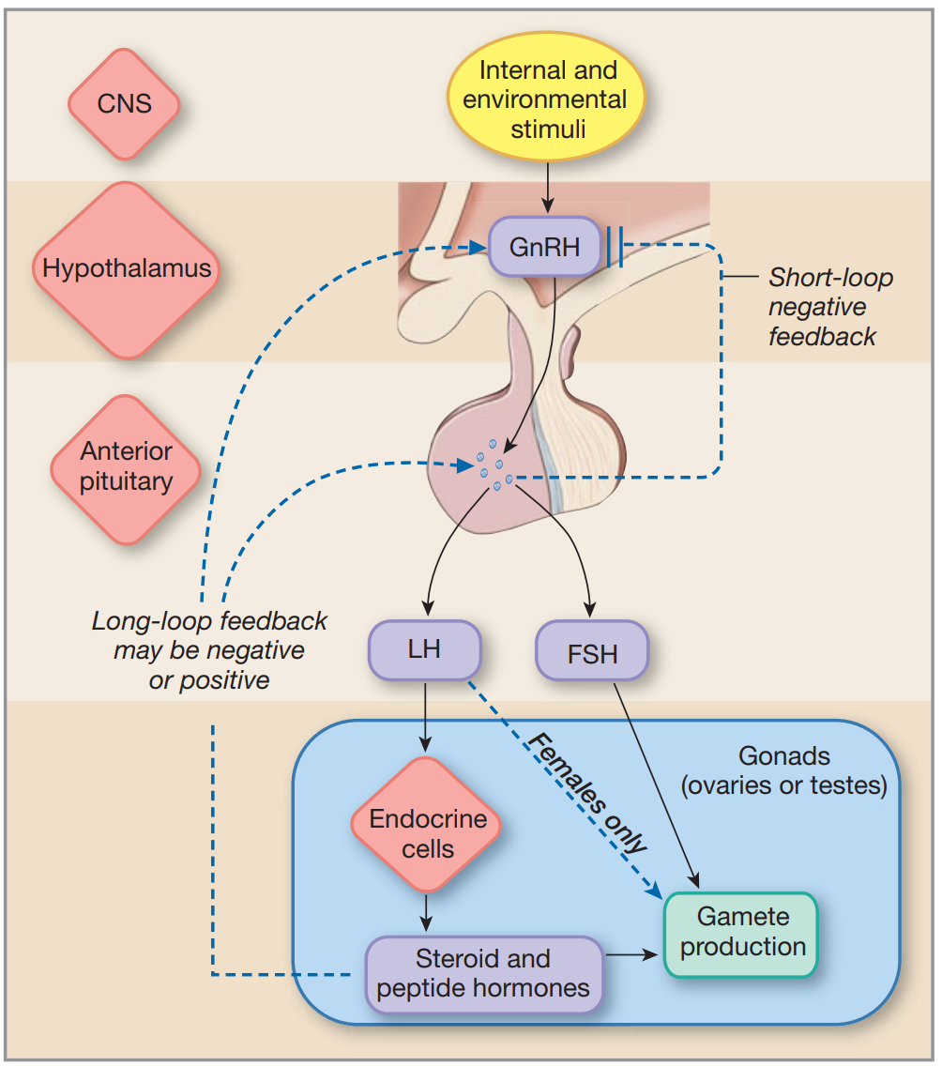
Notes:
Long-loop = control from a peripheral endocrine gland, short-loop = control from pituitary

Slide 7
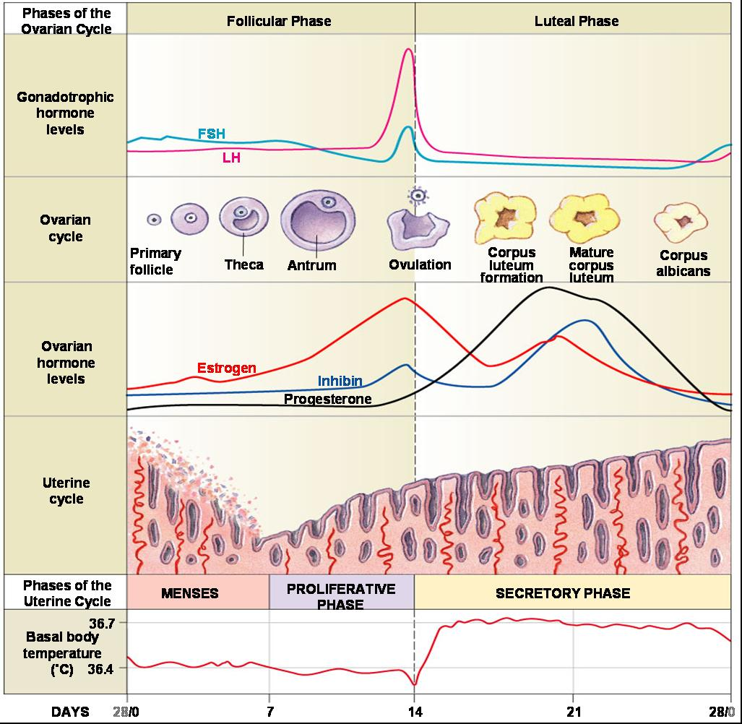
Ovarian/
Uterine/
Menstrual Cycle

Slide 8
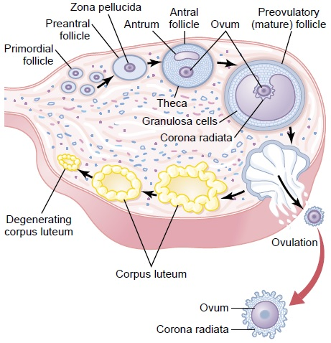
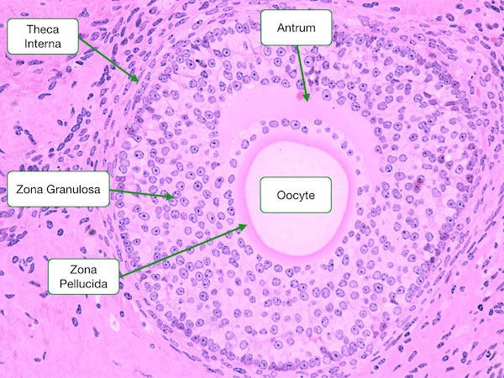
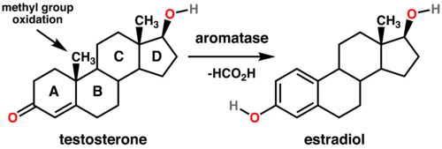
Ovarian Cycle
Follicle = egg + granulosa + theca
Theca -> androstenedione
Granulosa convert it into estrogen using aromatase
Notes:
Aromatase

Slide 9
Understanding the Cycle (Early Follicular Phase)
GnRH induce follicle growth
FSH stimulates follicles
More granulosa => more estrogen
LH stimulates theca
Allows granulosa to produce more estrogen
Self-sustained production
Dip in FSH/LH (inhibit anterior pituitary)
Tricky: suppress other follicle growth
Only one follicle is needed
Notes:
Follicles suppress one another by secreting AMH (Anti-Mullerian Hormone), so this further justifies why one follicle becomes dominant. Bistable system essentially, with one causing all others to die.

Slide 10
Understanding the Cycle
(Mid-Late Follicular Phase)
At a certain estrogen level, it flips:
Positive feedback on hypothalamus
Granulosa make inhibin, lowering FSH
Luteal surge => ovulation (egg release)
Primary oocyte finally divides!
Theca + granulosa => corpus luteum
Estrogen thickens uterine lining
Proliferative phase
Turning Point ->

Slide 11
Understanding the Cycle
(Early-Mid Luteal Phase)
LH FSH
Corpus luteum
High estrogen, progesterone, inhibin
Together inhibit hypothalamus
(Low FSH, LH -> don’t want more follicles)
Progesterone prepares endometrium further (capillaries, glycogen, lipids)
Secretory phase
Estrogen
Inhibin
Progesterone

Slide 12
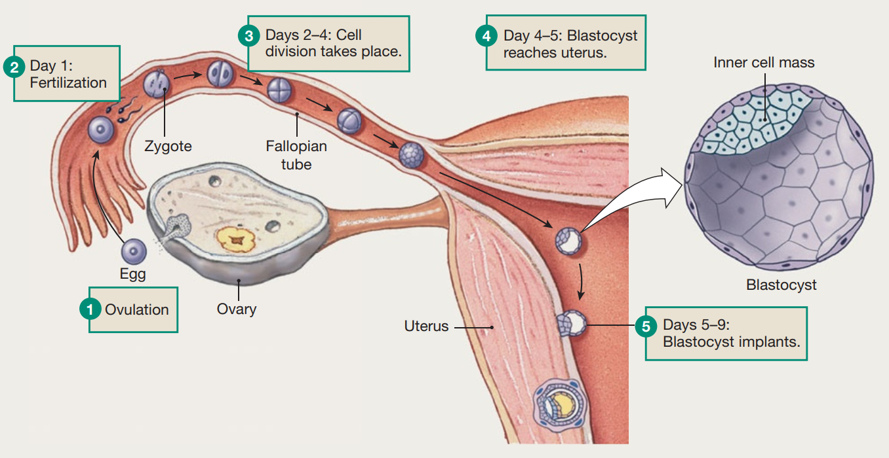
Understanding the Cycle
(Late Luteal Phase/Menstruation)
Corpus luteum degenerates to corpus albicans
Loss of estrogen/progesterone
Menses marks day 0 of next cycle, discharge of inner uterine lining/egg
Fertilization/pregnancy can save the egg
Human chorionic gonadotropin acts like LH
Maintain progesterone

Slide 13
5 minutes for problems :)

Slide 14
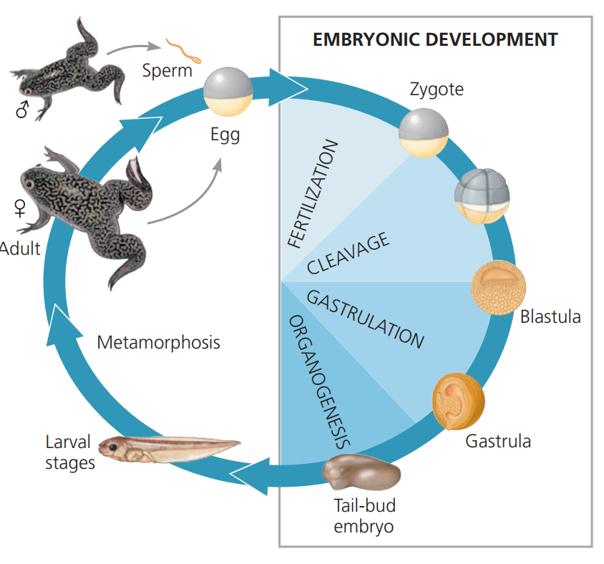
Developmental Biology
Fertilization
Cleavage
Morphogenesis
Gastrulation
Organogenesis

Slide 15
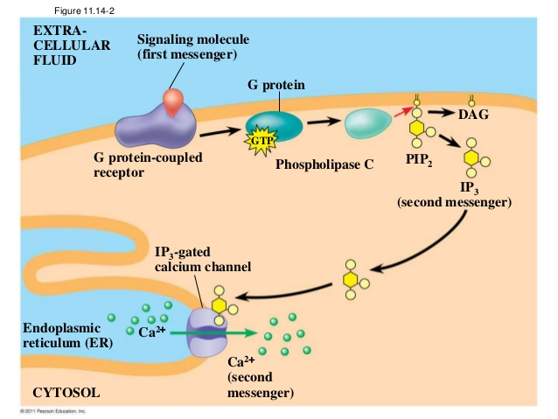
Fertilization
Mammalian sperm undergo capacitation
Ca²⁺ influx into sperm, cAMP increase
Blocks to polyspermy
Fast block - Na⁺ influx into egg
Sea urchins
Slow block - Ca²⁺ wave causes fertilization envelope + egg activation
Interesting note: PIP₂ -(phospholipase C)-> IP₃ and DAG
Sea urchins and mammals
Notes:
Sea urchins - thick jelly coat, sperm binds to vitelline layer
Mammals - corona radiata, sperm binds to thick zona pellucida

Slide 16
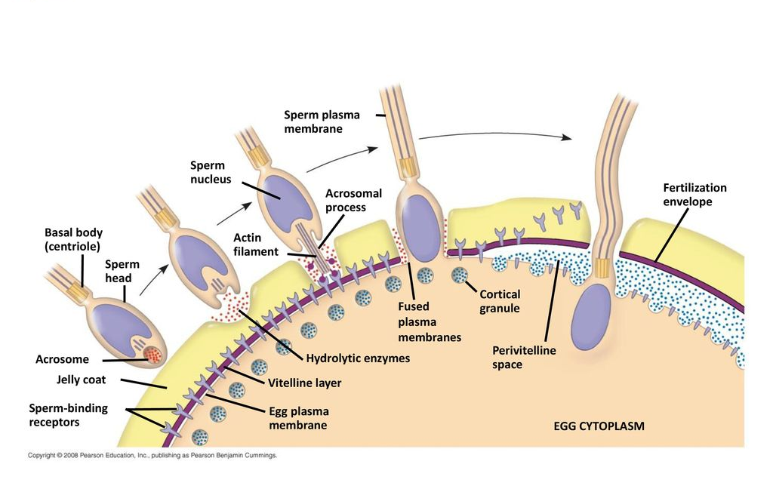
Slow block to polyspermy

Slide 17
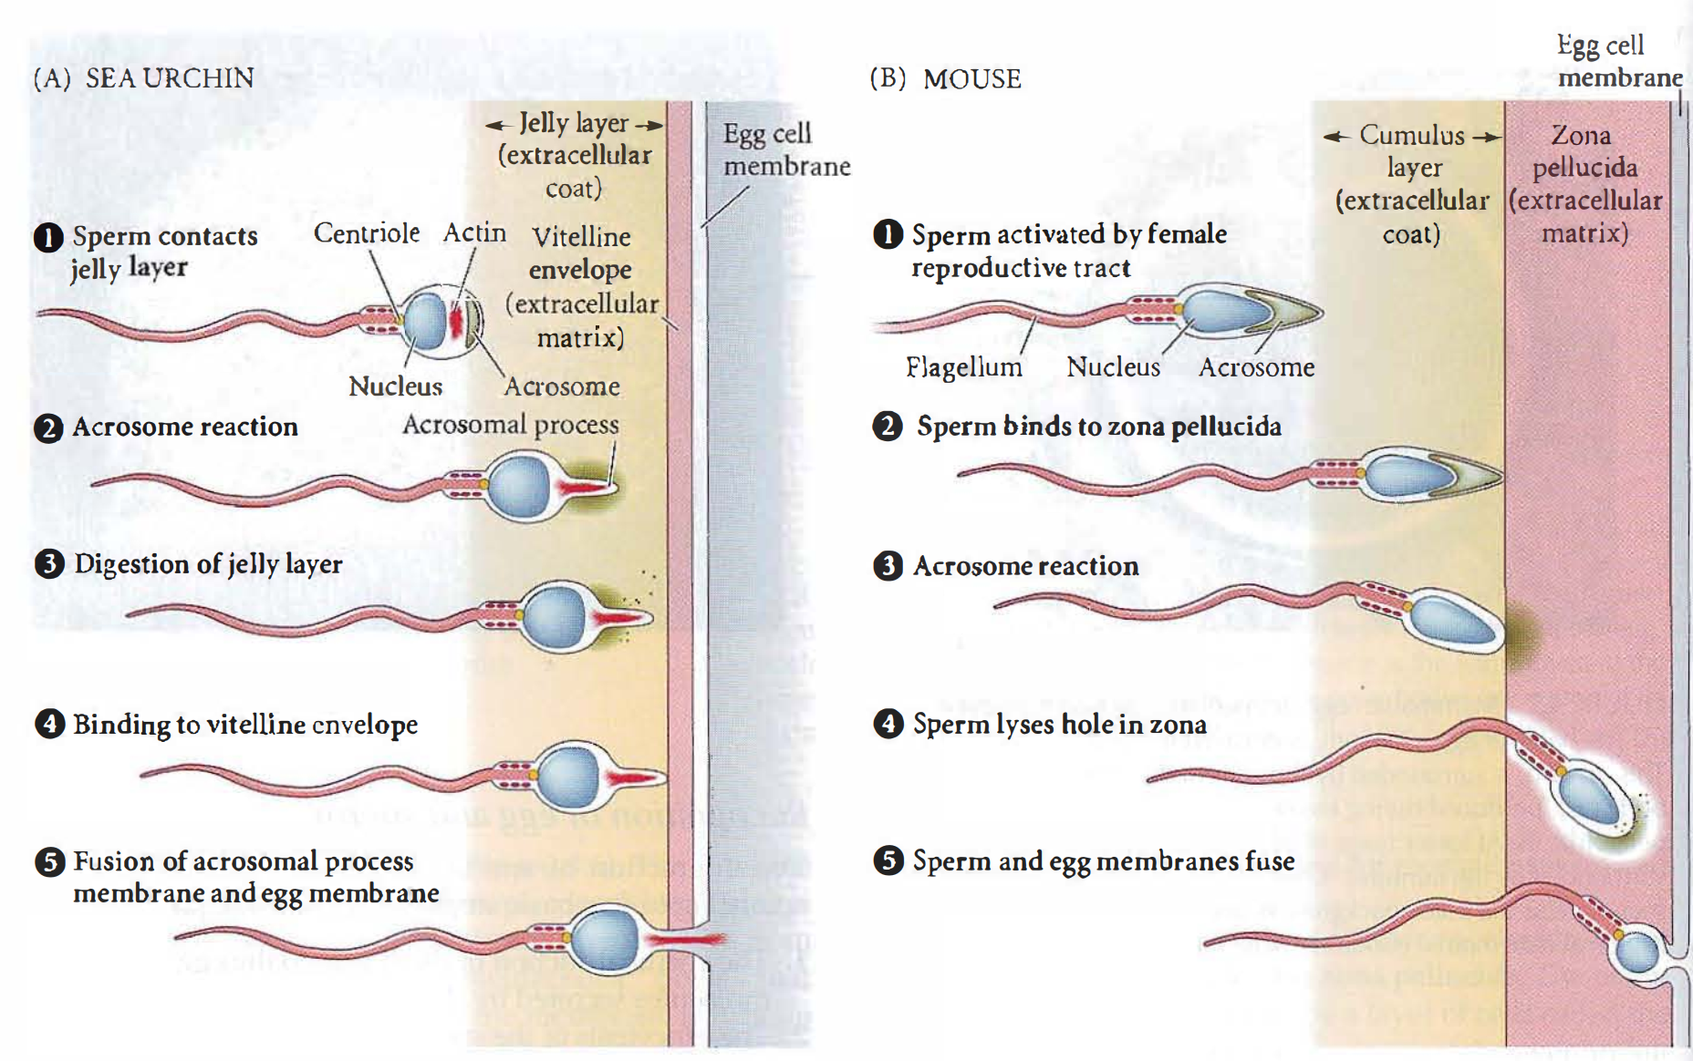
(Corona Radiata)
Notes:
The comparison between these two is really weird.
So we have three parts:
Extracellular coat, 2. Extracellular matrix, and 3. egg cell membrane
Sea urchin: Digestion in 1, binding in 2
Mammal: Digestion AND binding in 2.

Slide 18
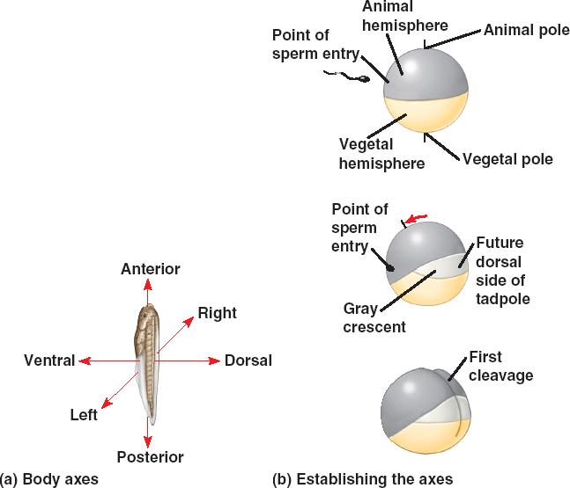
More events upon sperm binding
Cortical rotation, toward point of sperm binding
Forms gray crescent
Uses the sperm’s centrioles (MTOC)
Finish a several decade-long meiosis!
Fuse resulting nuclei with sperm nuclei

Slide 19
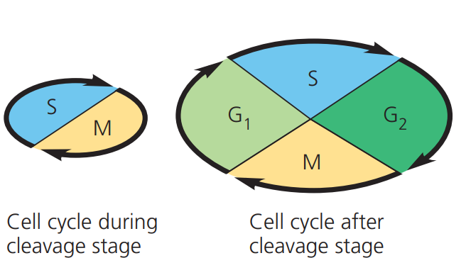
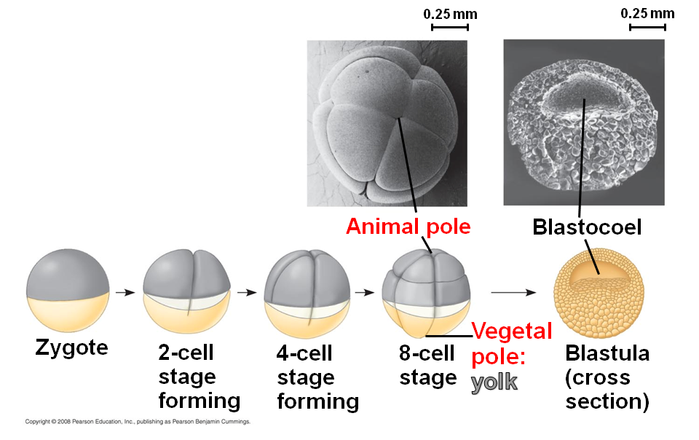
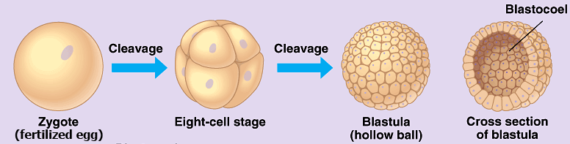
Cleavage
Skip G₁ and G₂, use the protein/mRNA stored up from oogenesis
Cleverly use nuclear-cytoplasmic ratio for regulation
Blastula = many blastomeres + blastocoel
Animal and vegetal pole
Holoblastic - low yolk
Echinoderms, mammals, annelids
Meroblastic - very yolky
Birds/other reptiles, fishes, insects
Notes:
Animal pole named so because it is “lively”, while vegetal just sits there…
I remember it saying vegetarians eat eggs => yolky side is vegetal-pole = vegetable
Very obscure facts:
1st division in frog is equatorial, and 2nd is meridional, but actually begins before the first one finished.
The 3rd one is also equatorial.
blast = sprout
mere = part kinda?

Slide 20
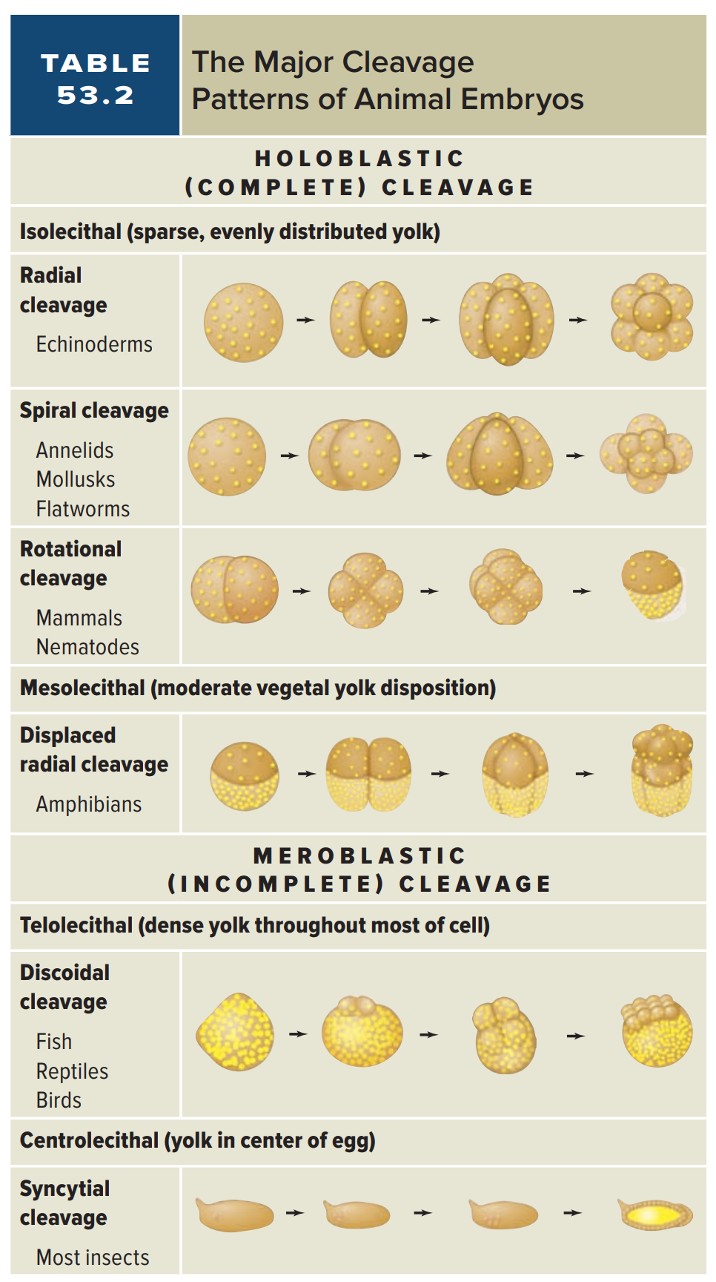
Not necessary but good
to be aware of

Slide 21
Morphogenesis - Gastrulation
Blastula -> gastrula
Establish embryonic germ layers/primitive gut
Diploblasts - two layers:
Cnidarians, ctenophores (radial symmetric)
Ectoderm and endoderm
Triploblasts - three layers:
Basically everything else - Bilateria
Adds the mesoderm
Notes:
Gastrula - little stomach. interesting?

Slide 22
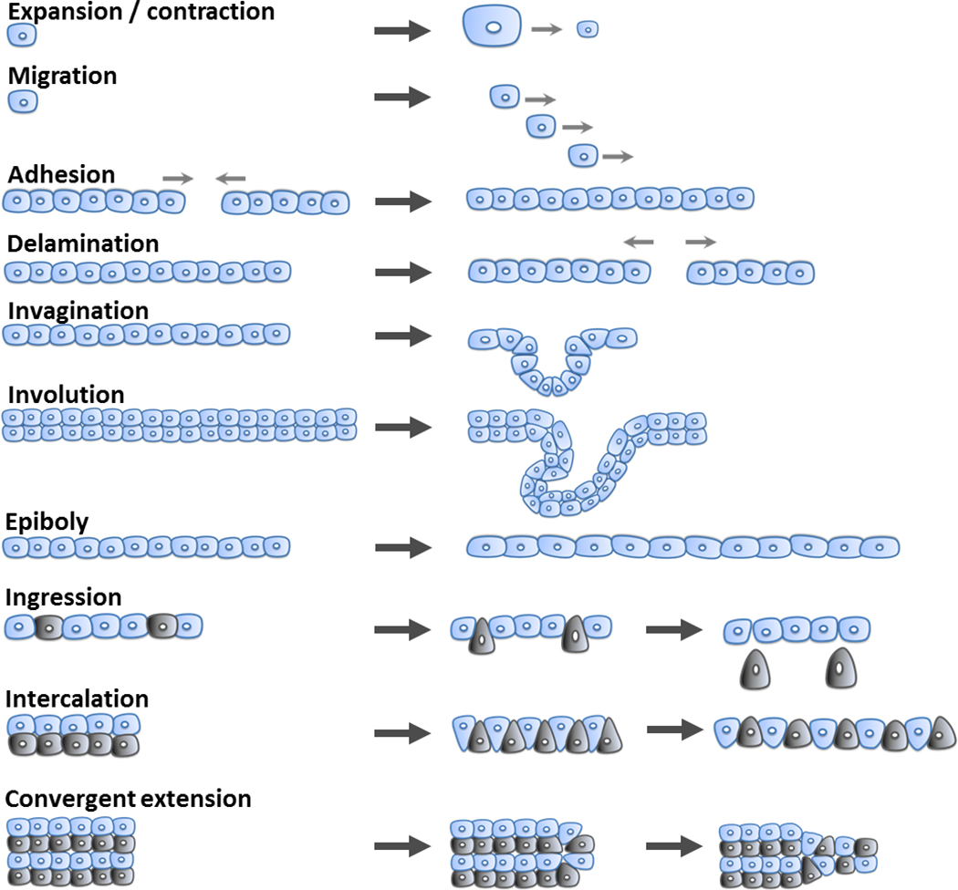
Cell Movement
Patterns
1.
2.
3.
4.
5.

Slide 23
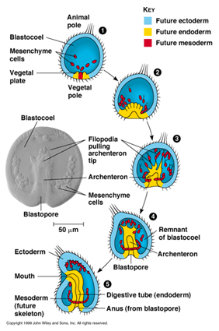
Gastrulation Patterns: Sea Urchins
Blastopore opens to archenteron - invagination
Primary mesenchyme cells - ingression
Filopodia drag archenteron through, forming the primitive gut tube
Deuterostome
Blastopore becomes anus, other side is mouth

Slide 24
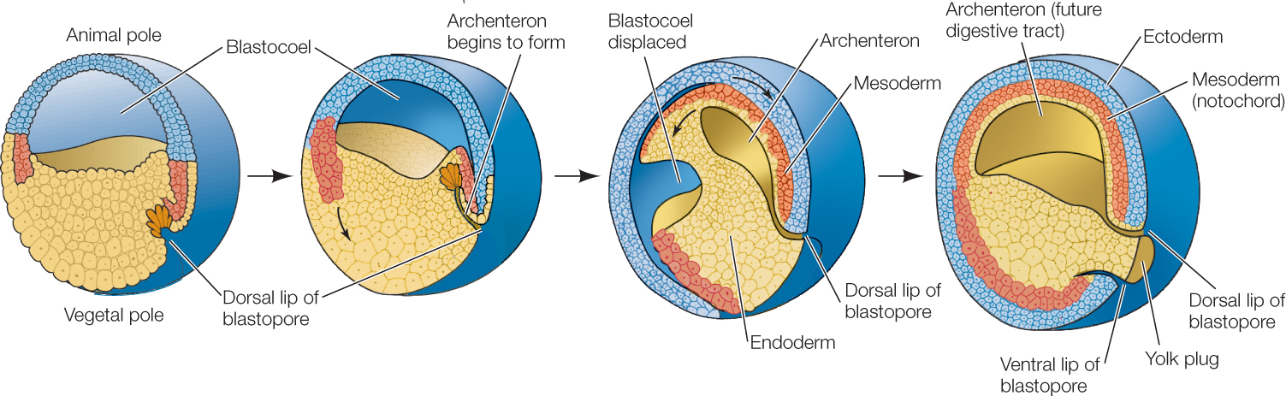
Gastrulation Patterns: Amphibians (Xenopus)
Invagination at gray crescent, forming dorsal lip of blastopore
Involution to form/expand archenteron while displacing the blastocoel
Epiboly of animal pole cells to form ectoderm, encircling the blastopore
Deuterostome - anus at blastopore, mouth breaks from archenteron

Slide 25
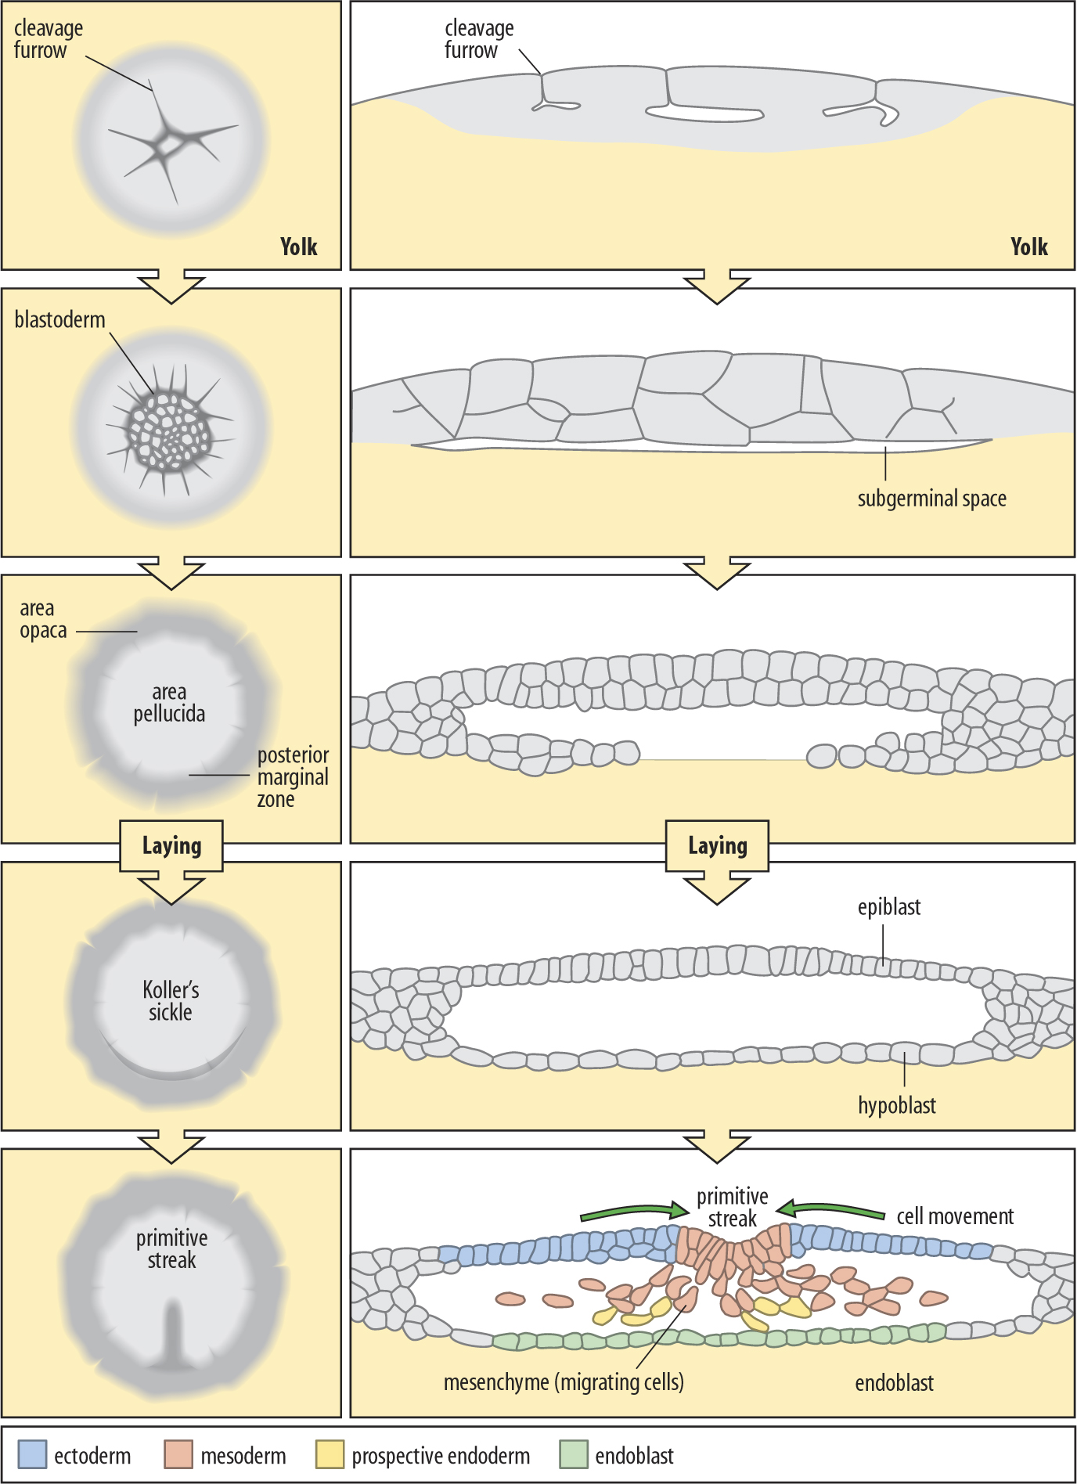
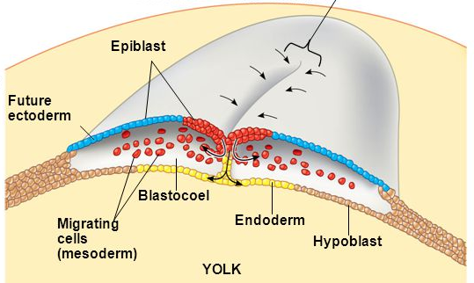
Gastrulation Patterns: Birds
High amount of yolk restricts area
Ingression at primitive streak of mesoderm
Delamination into epiblast and hypoblast
Epiblast forms all of embryo

Slide 26
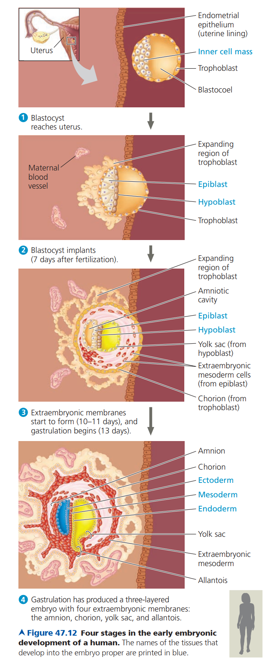
Gastrulation Patterns: Humans
Blastocyst = mammalian blastula
Inner cell mass = embryo proper
Splits into epiblast and hypoblast, like birds
Trophoblast = outer layer of blastocyst
Invades endometrium, contributes to placenta
Extraembryonic membranes (amniotes):
Chorion - gas exchange, later waste
Amnion - cushion
Yolk Sac - food supply, forms blood cells
Allantois - waste (leads to umbilical cord)

Slide 27
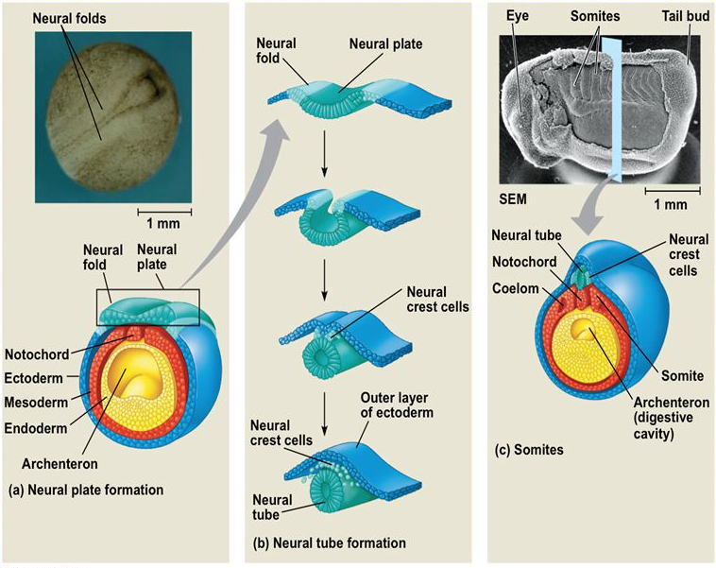
More Morphogenesis - Organogenesis
Main case: neurulation (Frog embryo)
Form spinal cord
Chordates
Induction by dorsal mesoderm

Slide 28
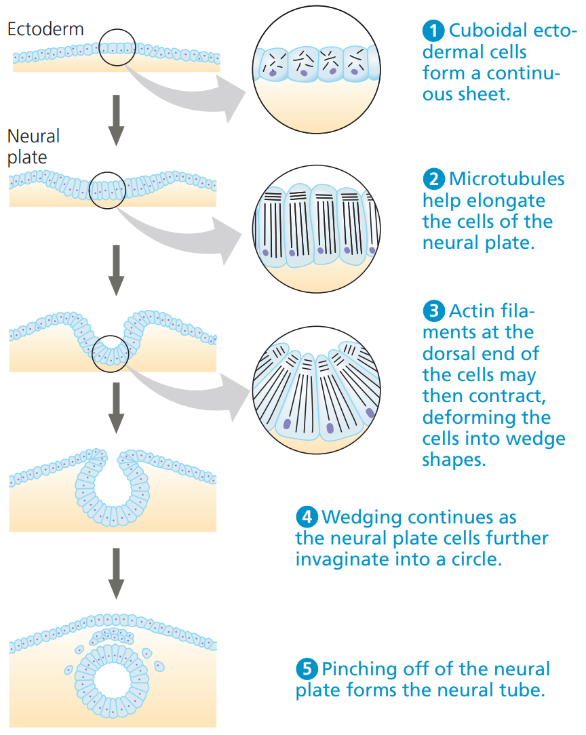

Slide 29
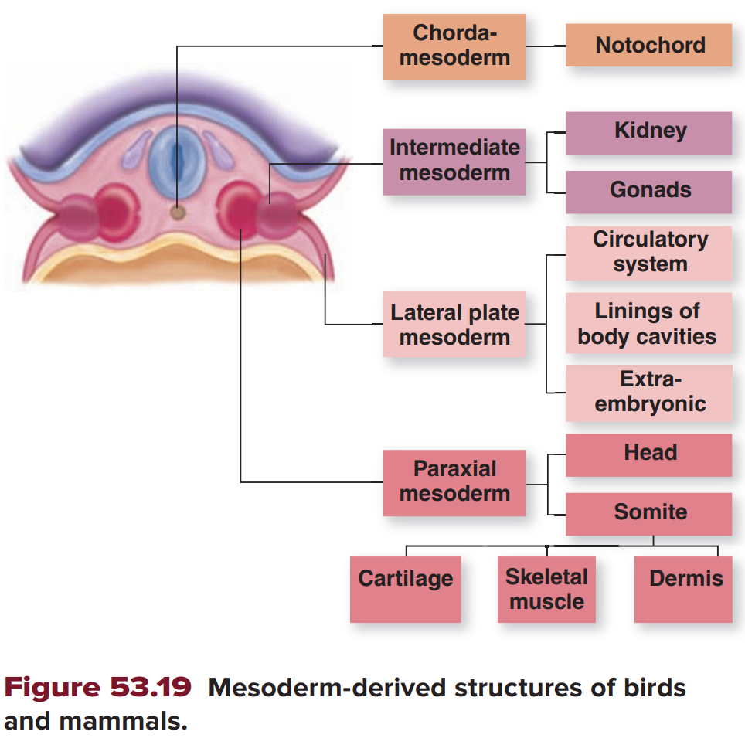
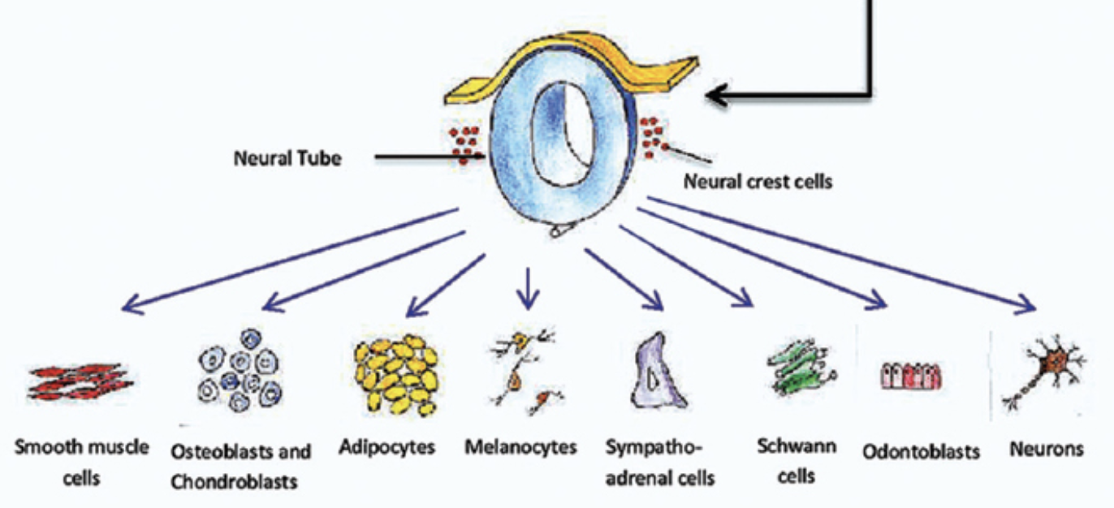
Cell Migration
Neural crest cells - teeth, skull bones, peripheral nerves
Somites - proof of segmentation, many derivatives
Cell adhesion molecules (CAMs) in extracellular matrix (ECM)
Notes:
Gastrula - little stomach. interesting?

Slide 30
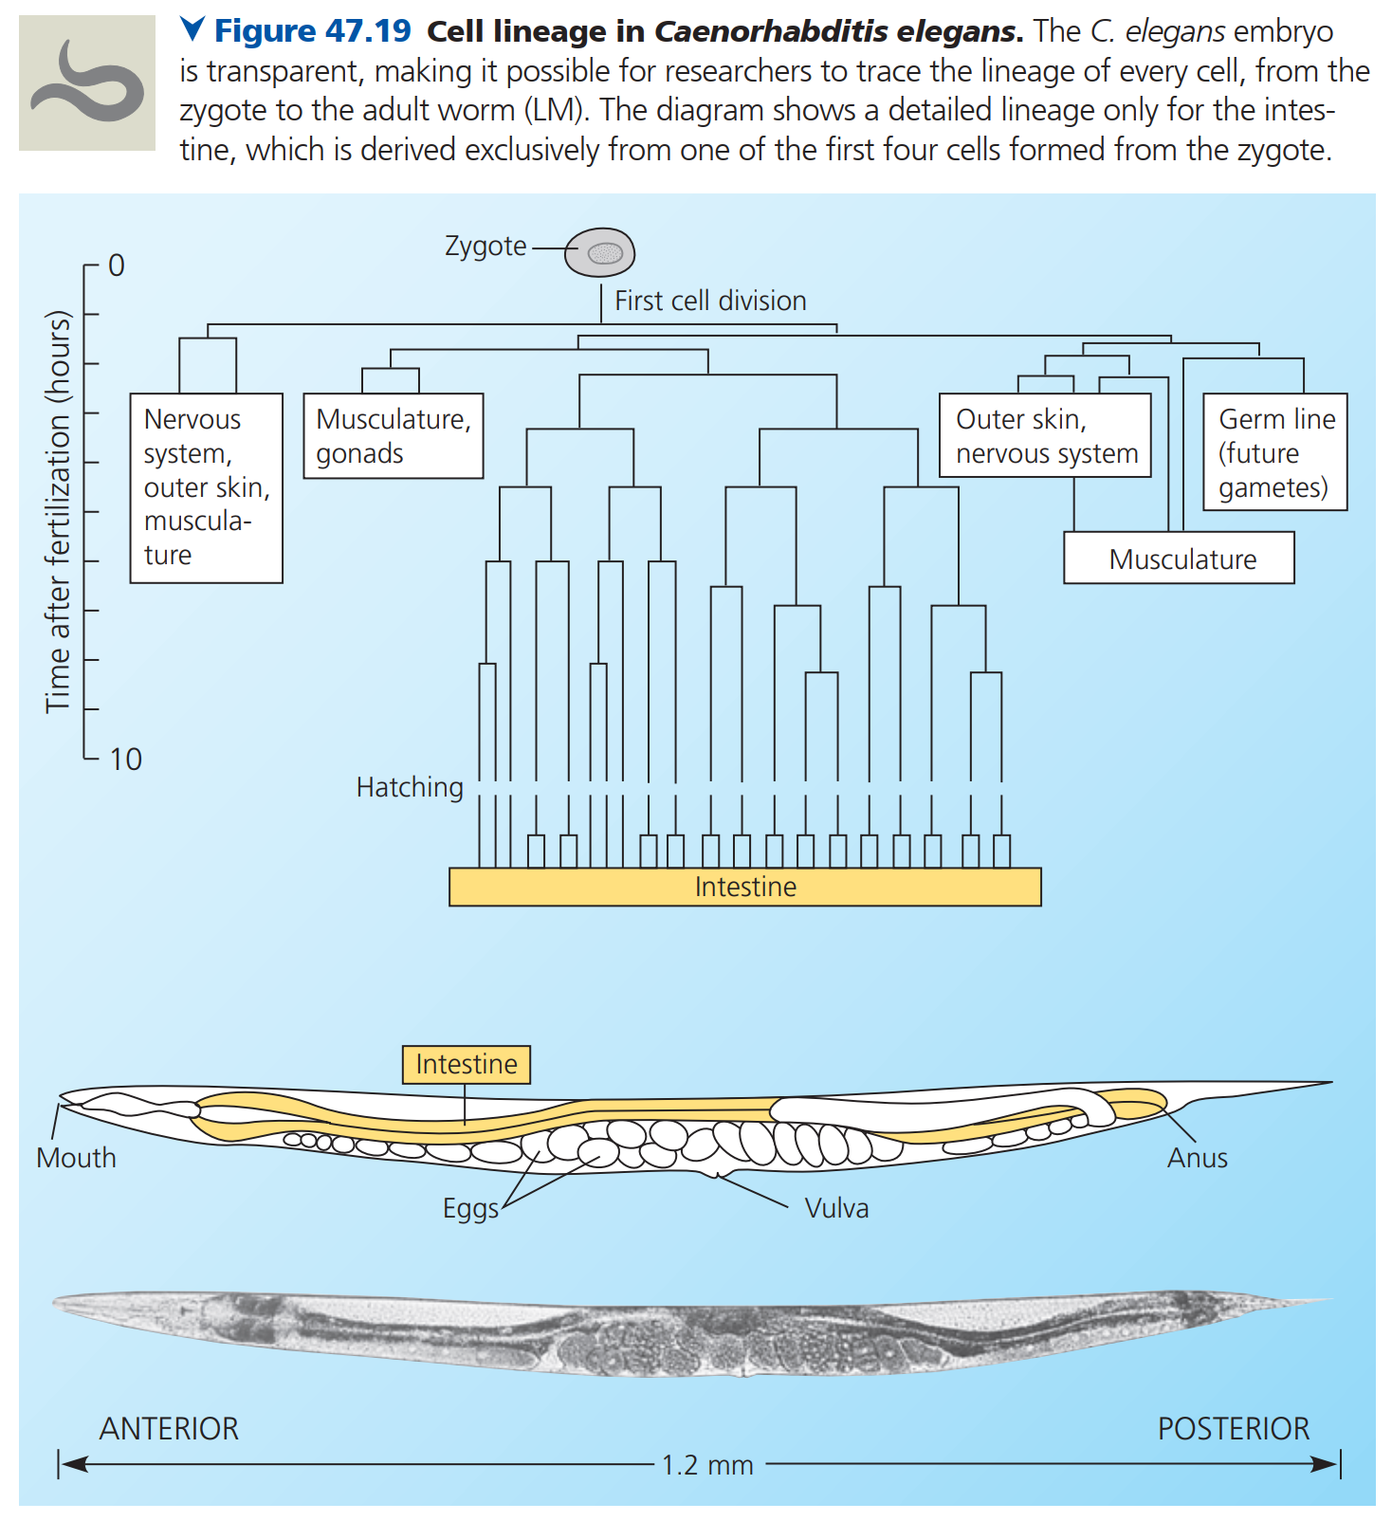
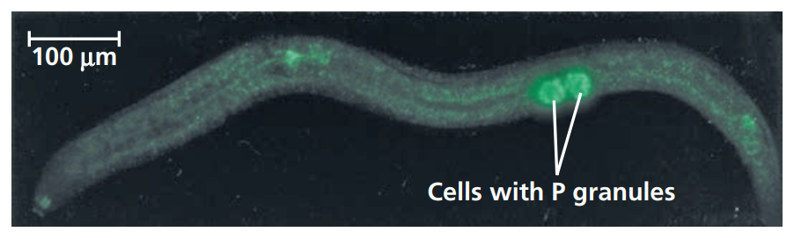
Cell Fate
Protostome - determinate, [spiral, schizocoelous]
Fate maps
P granules - posterior
Deuterostome - indeterminate, [radial, enterocoelous]
Targeted apoptosis
Notes:
Gastrula - little stomach. interesting?

Slide 31
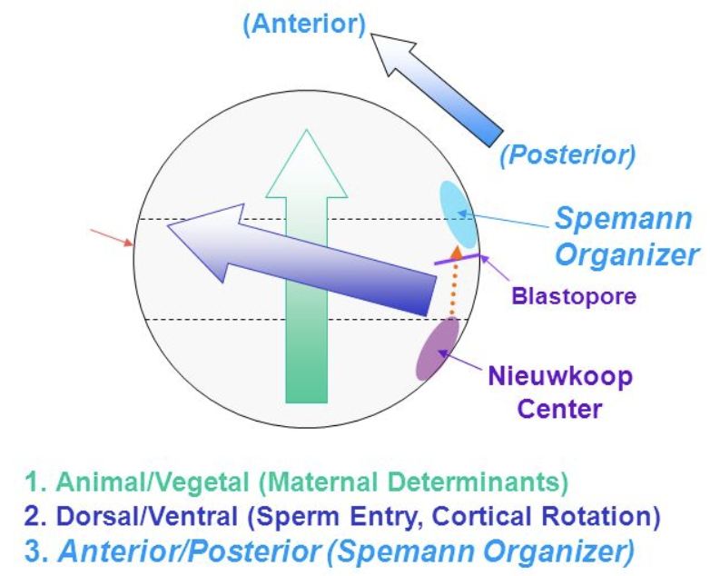
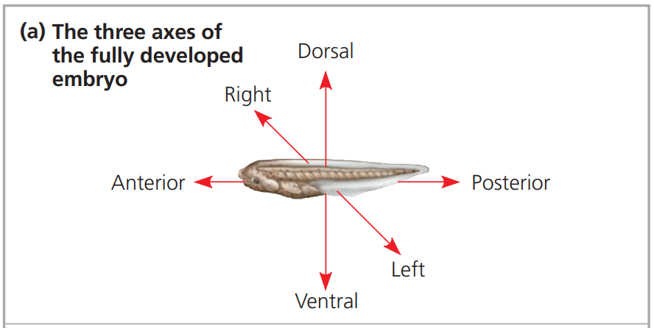
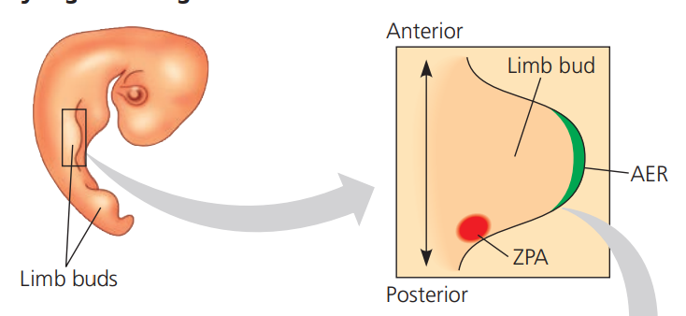
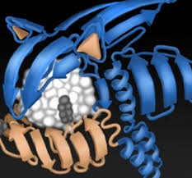
Axes Formation
Dorsal-ventral - Spemann’s Organizer
Bone morphogenetic protein 4 (BMP-4) - inhibit ventral development
Proximal-distal - Apical ectodermal ridge (AER)
Fibroblast growth factor (FGF) - distal bud growth
Anterior-posterior - Zone of polarizing activity (ZPA)
Sonic hedgehog (Shh) - posterior development
Hox genes control overall spatial patterns
Notes:
Gastrula - little stomach. interesting?

